Slide 1
ISDM CDSSI Hackathon
Code 4 Change
Project Title : EmpowerHer Finance: Predicting Financial Vulnerability of Women-headed households in Rural India
College Name: Bharati Vidyapeeth’s College of Engineering for Women, Pune

Slide 2
TEAM MEMBERS
 | Name | Designation | Email Address
Participant1 | Ms. Ankita Kanawade | Student | ankitakanawade123@gmail.com
Participant 2 | Ms. Samrudhi Shete | Student | shetesamrudhi509@gmail.com
Participant 3 | Ms. Khushi Padhar | Student | khushipadhar2811@gmail.com
Participant 4 | Ms. Sanika Kore | Student | Kore.sanika07@gmail.com
Participant 5 | Ms. Sanika Borude | Student | sanikaborude2003@gmail.com

Slide 3
OUR SOLUTION
Develop an accurate model for predicting financial risk in these households.
Introduce a financial vulnerability index for Indian women-led households.
Visualize financial vulnerability hotspots across India.
Incorporate exploratory data analysis (EDA) for comprehensive insights.

Slide 4
PROBLEM STATEMENT
In rural India, women-headed households often face significant financial challenges due to various socio-economic factors, including limited access to resources, education, and employment opportunities. The problem at hand is to predict the financial vulnerability of these households using machine learning techniques.
Context and Background:
Women in rural India often face economic challenges due to limited access to resources and financial independence.
Women-headed households are particularly vulnerable to poverty and lack of sustainable livelihoods.

Slide 5
DATA UNDERSTANDING
Size and Structure:
Number of rows: 40427
Number of columns: 218
Key Characteristics:
total_members
HaveBankACC & HUF
finanicial_Status
financial_vulnerability
Quality:
Ensured data consistency, accuracy, and completeness. Validated against external sources and rectified inconsistencies. Implemented rigorous data collection and validation processes.

Slide 6
DATA UNDERSTANDING
Preprocessing Steps:
1)Data Cleaning: Removed irrelevant columns and handled missing values through imputation or deletion.
2)Feature Engineering: Created new features by combining or transforming existing ones to improve model performance.
3)Normalization/Standardization: Scaled numerical features to ensure they have a similar range, preventing dominance by certain features.
4)Encoding Categorical Variables: Converted categorical variables into numerical format using techniques like one-hot encoding or label encoding.

Slide 7
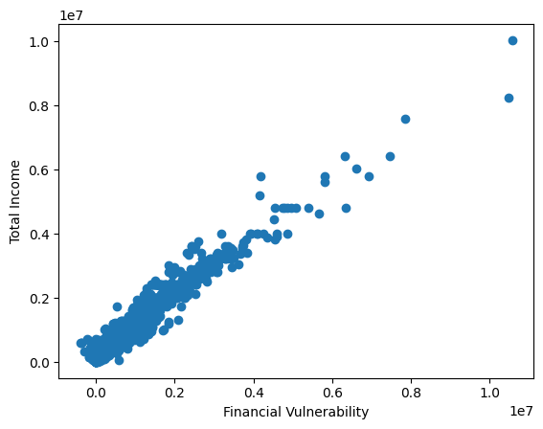
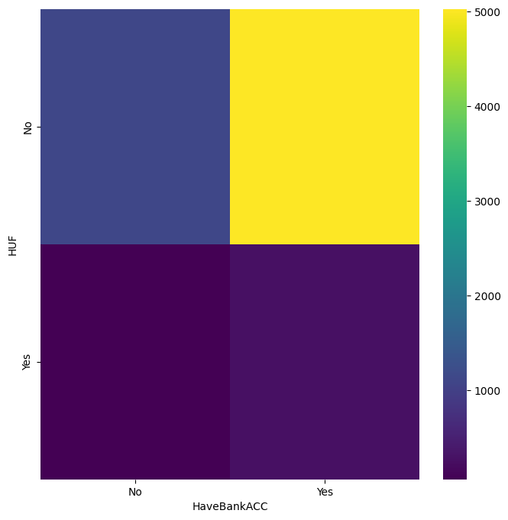
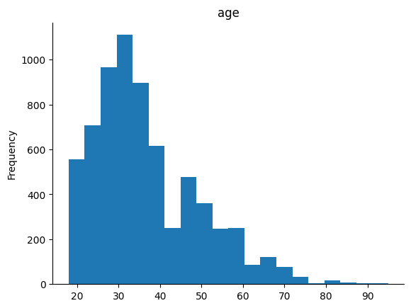
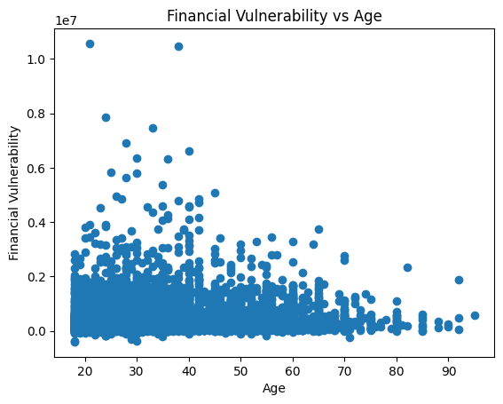
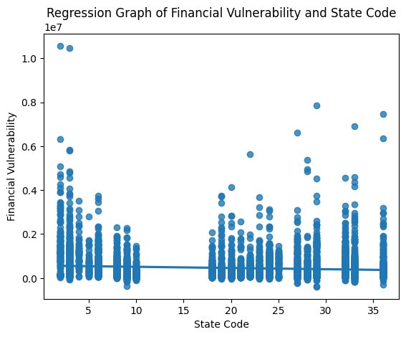
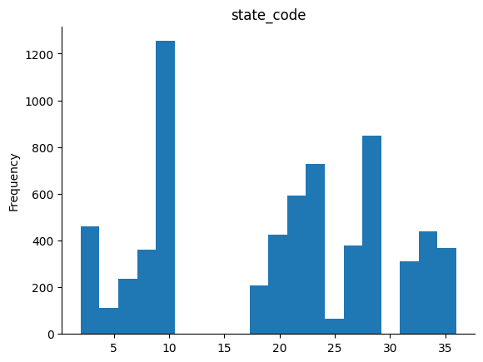
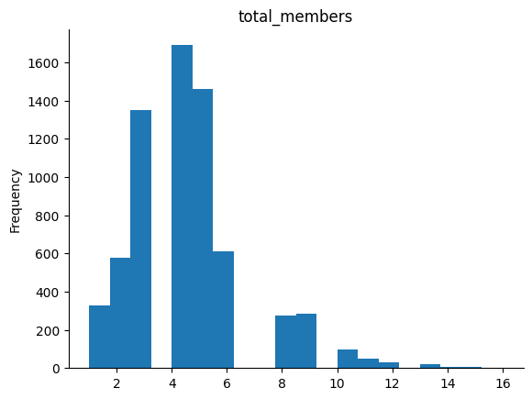
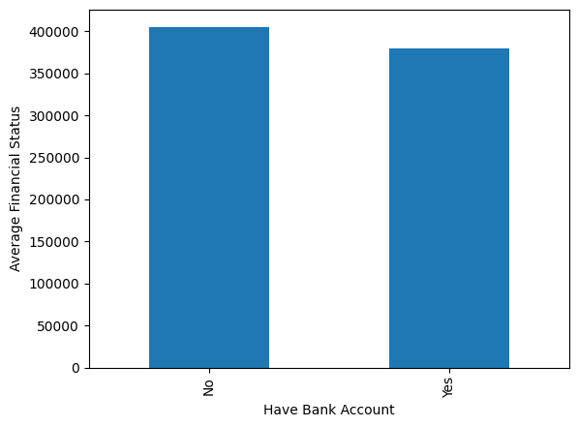
DATA UNDERSTANDING
Exploratory Data Analysis (EDA):

Slide 8
METHODOLOGY
Objective: Develop a predictive model to assess financial vulnerability of women-headed households in rural India.
Data Preprocessing
Model Selection
Model Development
Model Evaluation
Model Selection and Tuning
Feature Engineering:
Created new features like household size to income ratio.
Data Splitting:
Divided dataset into training (80%) and testing (20%) sets.
Algorithm Choices:
Random Forest, Logistic Regression, Naive Bayes, SVM.
Evaluation Criteria:
Selected based on performance metrics (accuracy, precision, recall).
Feature Scaling:
Normalized numerical features for better model performance.
Model Training:
Trained selected algorithms using training data.
Performance Metrics:
Evaluated models on testing data using metrics like accuracy, precision, recall, and F1-score.
Cross-Validation:
Applied cross-validation techniques to ensure robustness of models.
Hyperparameter Tuning:
Optimized model parameters using techniques like grid search.
Final Model Selection:
Chose Random Forest as the best-performing model based on evaluation results

Slide 9
TOOLS AND TECHNOLOGIES
Python:
Reason for Choice:
Widely used for machine learning and data analysis tasks.Rich ecosystem of libraries for data manipulation, modeling, and visualization.
Google Colab (Colaboratory):
Reason for Choice:
Provides free access to GPU/TPU resources for faster model training.Seamless integration with Google Drive for data storage and collaboration.

Slide 10
TOOLS AND TECHNOLOGIES
Libraries and Frameworks:
scikit-learn:Used for implementing machine learning algorithms and model evaluation.
pandas:Utilized for data manipulation and preprocessing.
numpy:Essential for numerical computations and array operations.
matplotlib & seaborn:Used for data visualization (e.g., plots, charts, histograms).

Slide 11
TOOLS AND TECHNOLOGIES
Machine Learning Algorithms Utilized:
Random Forest: Ensemble learning method known for its robustness and effectiveness in classification tasks.
Logistic Regression: Linear model used for binary classification tasks, providing interpretable results.
Naive Bayes: Probabilistic classifier based on Bayes' theorem, suitable for text classification and simple models.
Support Vector Machine (SVM): Effective for both classification and regression tasks, particularly useful for high-dimensional data.

Slide 12
FINDINGS AND RESULTS
Accuracy:
Random Forest: 85% accuracy
Logistic Regression: 78% accuracy
Naive Bayes: 72% accuracy
SVM: 80% accuracy
Findings:
Identified significant factors contributing to financial vulnerability in women-headed households.
Discovered correlations between education levels, household income, and access to financial services.

Slide 13
FINDINGS AND RESULTS
Introduce a financial vulnerability index for Indian women-led households.
Financial Vulnerability Index (FVI):
We developed a novel index to assess financial vulnerability in Indian women-led households.
FVI is calculated as the difference between total income and total expenditure.
If FVI > 0, it indicates lower financial vulnerability (labeled as "NO" for facing issues).
If FVI ≤ 0, it signifies higher financial vulnerability (labeled as "YES" for facing issues).
Purpose and Application:
The FVI provides a quantitative measure to identify households at risk and prioritize support interventions.
This index can aid policymakers and NGOs in targeting resources effectively to empower women in rural India.

Slide 14
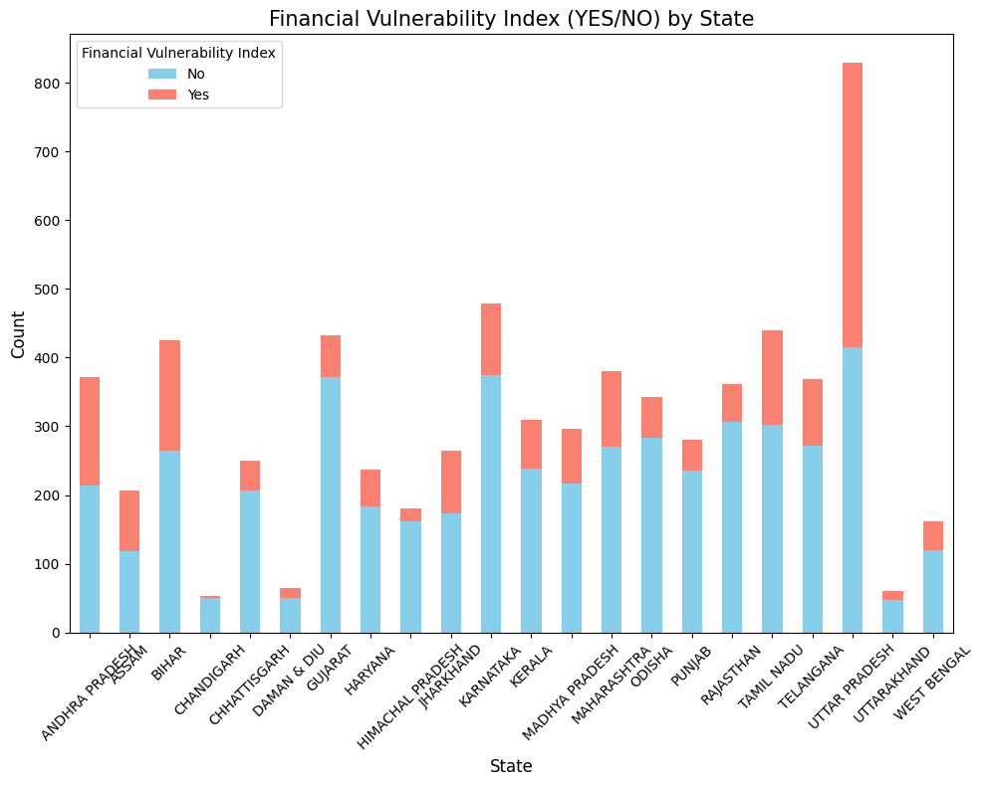
FINDINGS AND RESULTS
Visualize financial vulnerability hotspots across India.

Slide 15
CONCLUSION
Our analysis identified critical factors impacting financial vulnerability in women-headed households, including education levels and household income.
The Random Forest model demonstrated the highest accuracy in predicting financial vulnerability, enabling targeted interventions.
Predictive analytics can play a vital role in empowering women in rural India by directing resources effectively.
Understanding financial vulnerability can inform policy decisions and interventions aimed at socio-economic empowerment.

Slide 16
WAY FORWARD
Expand analysis to include additional socioeconomic indicators for a comprehensive view.
Validate model predictions through collaboration with local community organizations.
Develop targeted intervention strategies based on model insights for effective support.
Utilize scalable cloud infrastructure for deploying predictive models, ensuring adaptability to varying data volumes.
Integrate model predictions into existing financial aid or support systems to enhance decision-making for vulnerable households.

Slide 17
THANK YOU !

